Slide 1
Effects of different animal production systems on climate change
Dr. George P. Laliotis
Assistant Professor
Department of Animal Science – School of Animal Biosciences
Agricultural University of Athens
Latvia, 27 February 2020
Notes:
Thank you very much. Good morning to all of you… Previous speakers focused on the impact of climate change on livestock production, In my presentation I will try to focus the other side of the coin, thus the impact of animal production on climate change and if finally are livestock system have a flat impact or may differentiate on this impact.

Slide 2
Outline:
Introduction
-Livestock and climate change
Farming practices and environmental impact
-general management, breeding, manure treatment, feeds, etc
Impact of different farming systems on climate change
- Sheep farming systems
-Cattle farming system
-Broiler systems
-Egg production systems
Conclusions

Slide 3
Impact of Animal Production on Climate change
Τhe increased demands for livestock products is nowadays a certainty
      population growth
      urbanization
      income rise
      different nutritious needs
As a result the livestock sector:
      Requires a significant amount of natural resources
      Is responsible for about the 14.5 % of total anthropogenic greenhouse gas emissions (>7 Gigatons of carbon dioxide equivalents)
Notes:
Increased demands for livestock products in affluent as well as in non affluent countries, as a results of population growth, urbanization, rise of income and of course different nutritious needs, are nowadays a certainty.
As result, the livestock sector from the one side requires significant amounts of natural resources in order to cover the aforementioned demands, but from the other side is led to a environmental dead-end as the sector is responsible for the almost 15% of the total anthropogenic greenhouse gas emissions.

Slide 4
Impact of Animal Production on Climate change
Notes:
We almost all are familiar with such figures…. Green house emissions from livestock accounts mainly for carbon dioxide, methane and nitrous oxide and the largest sources of these emissions are enteric fermentation, feed processing, manure management as well as transportation andfurther processing of animal products.

Slide 5

Impact of Animal Production on Climate change
Beef cattle
Dairy cattle
Small Ruminants
Pigs
Poultry
Notes:
(We almost all are familiar with such figures…. Previous speakers have already analyzed some of them noting the impact of livestock to climate change… Briefly…. ). Ruminant sector and especially beef cattle sector followed by dairy cattle and buffalo sectors are considered as the main contributors of livestock to greenhouse gas emissions, reaching almost over the 80% of the total Gtns carbon dioxide equivalents, mainly due to the high enteric fermentation observed on the breeding animals of these sectors . The small ruminant sector, as well as pig and poultry sector are participate the lesser to this environmental impact.

Slide 6
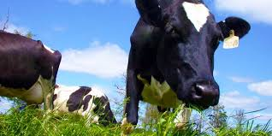
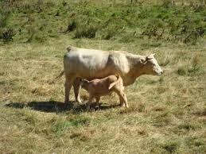
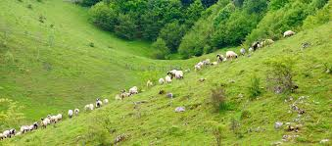
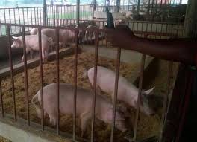
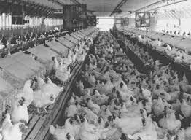
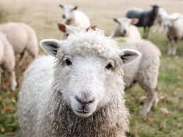
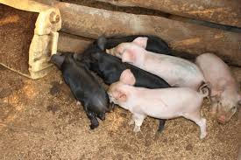
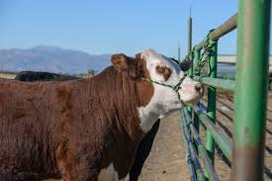
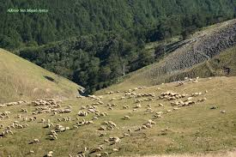
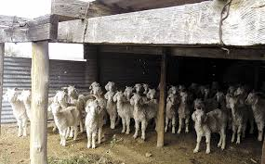
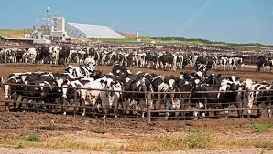
DO ALL THE FARMING SYSTEMS HAVE THE SAME ENVIRONMENTAL IMPACT ???
Notes:
The question that may raise focusing on these statistics is whether all farming system contribute the same to the livestock environmental impact or there are different ions among them.

Slide 7
Farming systems and management practices: Some examples….
Mixed crop-livestock systems account for 64% of global methane emissions.
Grazing systems account for 35% and industrial for 1% of global enteric fermentation.
Changing feeding practices moderate methane emissions.
-A 1% increase of dietary fat can decrease enteric methane emissions between 4-5%.
-Feed antibiotics can reduce enteric fermentation.
    -Reduced protein intake may lead to decrease the nitrogen excreted by animals.
-Improving diet digestibility by increasing concentrate feeding may reduce by 15%
methane emissions per unit of fat protein corrected milk.
- Physical processing of forages, i.e chopping or grinding, improve digestibility lower (in a
small extent <2%) enteric methane production in ruminants

Slide 8
Farming systems and management practices: Some examples….
Changes in manure management lead to lesser emissions.
-Frequent removal of manure to an outside storage facility could reduce methane
and nitrous oxide emissions >40%.
-Solid-liquid separation process of manure could lead to a 30% lesser emissions
compared with untreated manure.
-Same positive effect may have the anaerobic digestion of manure, when biogas
generated from the process is used in the livestock
Feed management and GHG emissions.
-Fertilizers and manure are the major contributors of GHG emissions related to
feed production and further processing.
-Lower methane emissions occur after manure land application, thus a decrease of
storage time could assist in reducing GHG emissions.
-Rotational grazing systems may lead to reduce nitrous oxide emissions (via
stocking densities and grazing duration management).

Slide 9
Farming systems and management practices: Some examples….
Animal management and breeding strategies
-The more productive the animal is the lower environmental impact will have
(per unit of product).
-Breeding for more productive animals may lead to a diminish of the nutrient
requirements→ assist to lower GHG emissions.
-Improved fertility in dairy cattle could lead to a reduction in methane emissions by
10–24% and reduced nitrous oxide emissions by 9–17%.
- Cattle diseases can increase greenhouse gas emissions up to 24% per unit of produced milk
and up to 113% per unit of produced beef carcass.
Multi-actor drivers …..

Slide 10
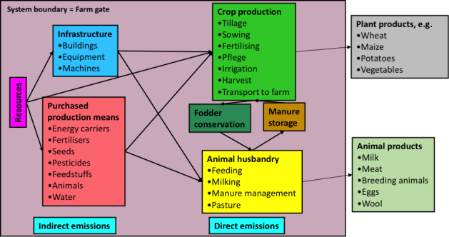
ENVIRONMENTAL IMPACT OF FARMING SYSTEM
AS A HOLISTIC APPROACH
Notes:
What if we want to follow a holistic approach for examining the environmental impact of farming systems? Of curse results depend on where we set the boundaries of the examined system (i.e. only direct emmisions, the farming gate, the slaughterhouse gate etc)

Slide 11
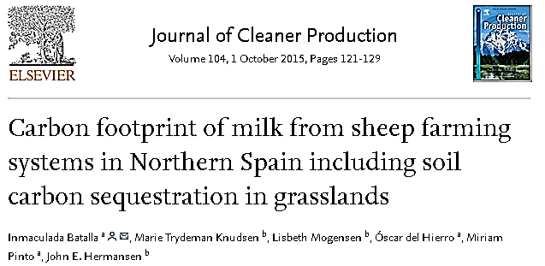
Approaches on farming systems ….
Carbon footprint of sheep milk was estimated on 12 farms in Northern Spain.
Three different farming systems
-FSI: Semi intensive system and foreign breed.
Kept indoors-no pasture management.
-LSI: Semi intensive system and local breed.
Low time grazing per year.
-LSE: Semi extensive system and local breed.
Grazing in mountain uplands during summer.
Carbon footprint estimation (LCA method) + soil carbon sequestration inclusion
Boundaries: Emissions on farm and emissions associated with production of inputs to the farm. Machinery, buildings and medicines were excluded.

Slide 12
Approaches on farming systems ….
The carbon footprint / unit of produced milk ranged from 2.0-to 5.2 kg CO₂eq/kg.
the carbon footprint decreased with the increase of milk yield per sheep.
more intensive farms with higher levels of milk production per sheep had lower carbon
footprint values than more traditional farms with lower efficiency per animal.
BUT, when soil carbon sequestration was included in the calculations, no difference was found in the carbon footprint of sheep milk from different systems and breeds.

Slide 13
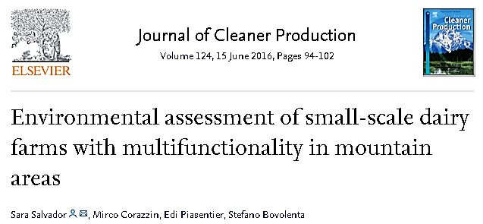
Approaches on farming systems ….
Εnvironmental impact of organic and conventional small-scale dairy farms in mountain areas
16 small-scale dairy farms (East Italian Alps) breeding a local cattle breed, Rendena
Boundaries: all the inputs/processes up to the production of milk. No transport or further processing of milk were included. All the processes related to the on-farm activity (i.e., the animal's rations, manure storage, cropping system, and fuel consumption) were taken into account.

Slide 14
Approaches on farming systems ….
Over 80% of the total emissions were addressed to milk in both cases, with a lower percent in organic farms (82% vs 87%).
Enteric fermentation were statistically greater in organic farms.
CO₂-eq emission appeared rather similar between the organic farms and the conventional (either when only produced milk were taken into account or beef as co-product).
The organic farms had a significantly lower eutrophication impact than the conventional farms.

Slide 15
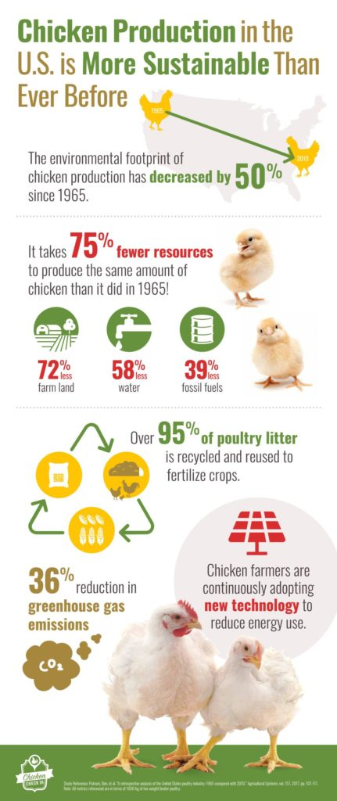
Approaches on farming systems ….
Producing the same amount of chicken today as 1965 has 50% less impact on the environment.
Many factors contributed to the reduced environmental impact including:
75% fewer resources required in poultry production;
39% lesser fossil fuels;
72% decrease in farm land used in poultry production;
58% decrease in water used in poultry production.
+++ environmental friendlier energy sources ….

Slide 16
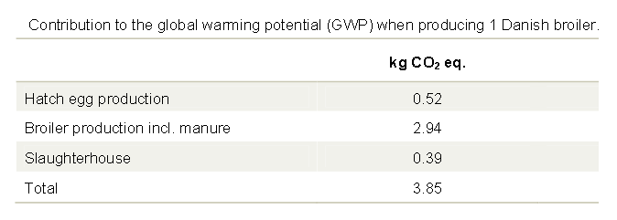
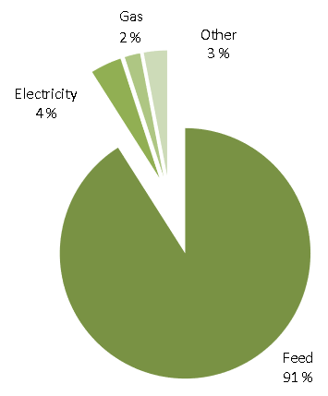
Approaches on farming systems ….
Source: Greenhouse Gas Emission from the Danish Broiler Production estimated via LCA Methodology. 2011

Slide 17
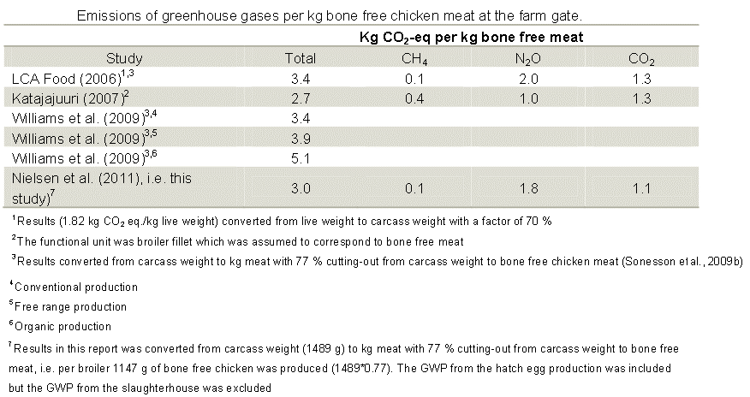
Conventional production
Free range production
Organic production
Notes:
Similar but not comparable results due to different methods that have been used and different boundaries of farming system assessment have been reported by previous authors. Interestingly, higher emissions of carbon dioxide where observed in an organic broiler system when compared to a free range or a conventional system. Main contributors to this differences may be a) a low N-efficiency in the broiler manure and therefore high N2O emission and low substitution of artificial fertilizer, 2) low efficiency and high usage of fossil fuels in feed production and 3) a high usage of fossil fuels in the heating of broiler houses

Slide 18
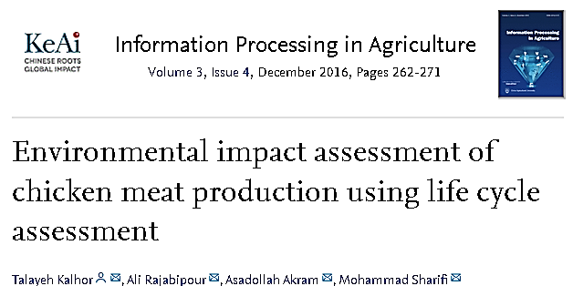
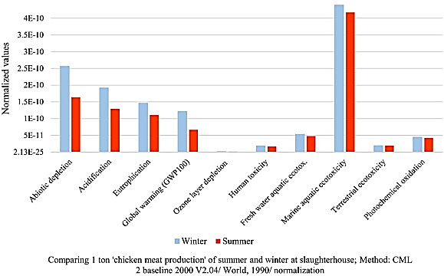
Case 1: Production of chicken meat in summer.
Case 2: Production of chicken meat in winter.
40 broiler producers+ 1 slaughterhouse (Iran)
The system boundary comprised all inputs from
-the broiler production in farms (e.g. feed
ingredients and detergents production) to the
slaughterhouse gate (packed meat).
-No further environmental impacts after the
slaughterhouse were included.
Machinery and buildings were not considered in the calculations.
The global warming potential, acidification and eutrophication for production of 1 ton packed meat were higher in winter than in summer.
The production stage was the main source of environmental impacts (over 50%)

Slide 19
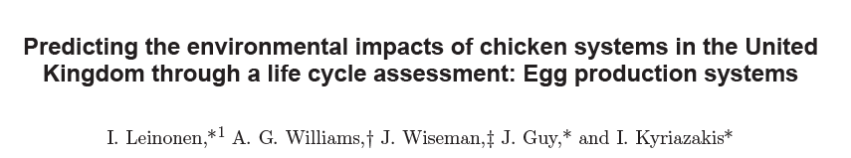
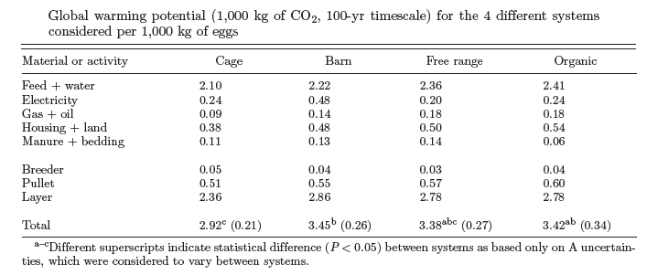
Approaches on farming systems ….
2012 Poultry Science 91 :26–40

Slide 20
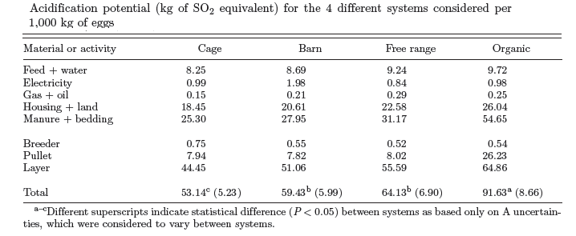
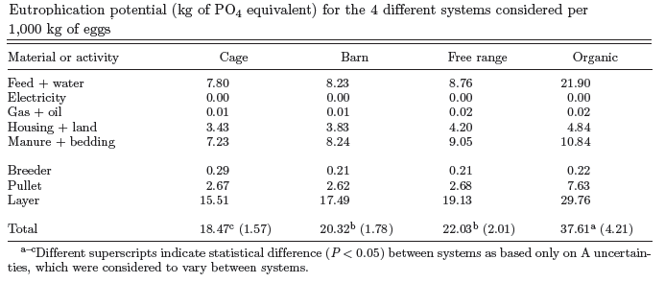
2012 Poultry Science 91 :26–40
Relatively large differences in many categories of the environmental impacts between the 4 different egg production systems. Main contributors apart production itself: feed, manure, electricity.
Differences in productivity largely affected the differences in the environmental impacts between the systems.

Slide 21
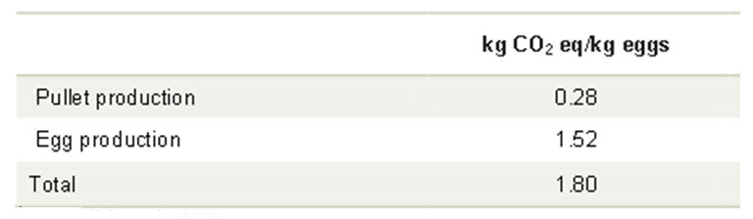
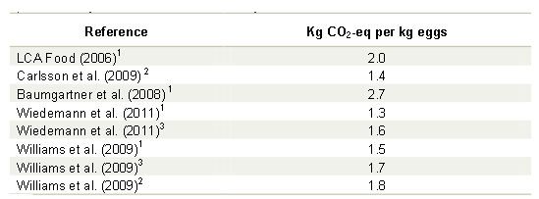
1: conventional/cage production; 2: organic production; 3: free range production

Slide 22
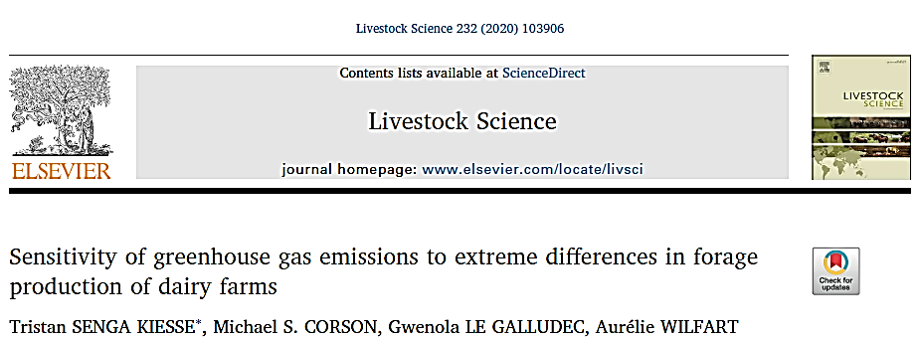
78 dairy cattle farms in Normandy (France)
Holstein breed, Normande or cross-breeds
15–20% of dairy farms with extreme minimum amounts of dry matter (DM) intake from pasture grass or maize silage
10–15% of farms with extreme maximum amounts of DM intake from one or the other source (grass or maize)

Slide 23
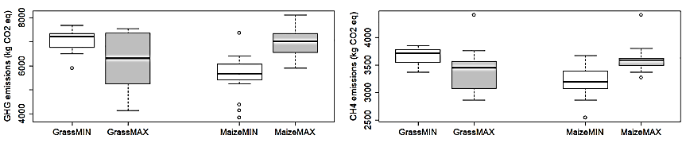
Gross emissions (emissions /farm/year)
CO₂
CH₄
Farms with high DM intake from grass (GrassMax) had 13% lower global warming potential than farms with low DM intake (GrassMIN)
Farms with high DM intake from maize (MaizeMax) had 25% higher warming potential than farms with low DM intake (MaizeMIN)
On farm energy consumption did not differ.
Same trends like GHG emissions for CH₄ emissions .
- 6% lower for GrassMAX than GrassMIN
- 12% higher for MaizeMAX than MaizeMIN
Notes:
Farms with high DM intake from grass had 13% lower global warming potential that farms with low DM intake. On the other hand, farms with high DM intake from maize had 25% higher warming potential in terms of CO2 eq. Same trend was observed for methane emissions in both cases.

Slide 24
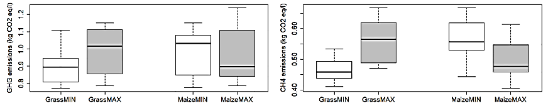
Emissions (expressed in 1 lt produced milk)
CO₂
CH₄
Farms with high DM intake from grass (GrassMax) had 17% higher global warming potential than farms with low DM intake (GrassMin).
Farms with high DM intake from maize (MaizeMax) had 1% lower warming potential than farms with low DM intake (MaizeMax).
On farm energy consumption did not differ.
Same trends like GHG emissions.
- 20% larger for GrassMAX than GrassMIN
- 11% lower for MaizeMAX than MaizeMIN
Notes:
When the unit of the expressed results changed to 1lt of produced milk (thus taking into account the emission intensity and not gross emmisions), an opposite trend was noted. Thus, Farms with high DM intake from grass had 17% higher global warming potential that farms with low DM intake. On the other hand, farms with high DM intake from maize had 1% lower warming potential in terms of CO2 eq. Same trend was observed for methane emissions in both cases.
Strategies setting DM Grass and DM Maize at extreme levels results in a change in annual GHG emissions whose direction (decrease or increase) tends to
depend on the FU chosen: gross emissions per farm (kg CO2 eq/farm/year) or emission intensity of milk (kg CO2 eq/l milk). One strategy is to
minimize DMMaize, which implies minimizing gross emissions but producing less milk than the dataset mean, meaning that emission intensity
increases. A second strategy is to minimize DMGrass, which keeps gross emissions nearly constant and maximizes milk production, meaning
that emission intensity decreases. A third strategy is to maximize DMGrass, which implies decreasing gross emissions and milk production
(the former more than the latter), meaning that emission intensity decreases. Finally, a fourth strategy is to maximize DMMaize, which implies
increasing gross emissions and milk production (the former more than the latter), meaning that emission intensity increases. In these four
strategies, CH4 emissions tended to vary in the same way as total GHG emissions, contributing approximately half of the farms’ GHG emissions.

Slide 25
Conclusions….
Impacts of farming systems on climate change is a certainty, but the “gravity” of this impact depends on the studied livestock’s boundaries.
Farming system practices (i.e. organic farming, DM intake, manure treatment etc.) influence the environmental impact of a livestock.
Although many farming systems withing the same or different species have been studied results are not (easily) comparable due to different approaches (different functional units, boundaries, statistical analysis etc.).
Common agreed guidelines for comparing the impact level of each livestock farming system on climate change may be a solution or case study approach would be a more accurate solution.

Slide 26

THANK YOU
FOR YOUR ATTENTION

