Slide 1
27.02.2020.
Cost-effective ammonia emissions reducing measures in agriculture
Assoc. prof., Dr.oec. Dina Popluga
Assoc. prof., Dr.agr. Dzidra Kreišmane

Slide 2
Topicality
86% of ammonia emissions come from agriculture, therefore measures for ammonia emissions reducing must be targeted to the agricultural sector.

Slide 3
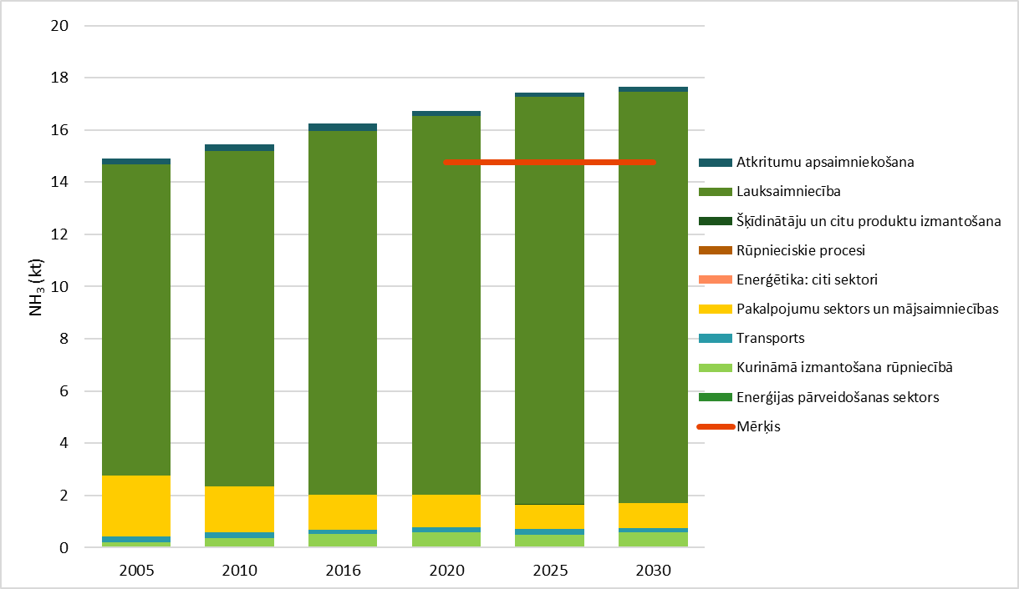
Topicality
Ammonia emissions projections with current policy
Directive 2008/50/EC of the European Parliament and of the Council of 21 May 2008 on ambient air quality and cleaner air for Europe sets emission targets for EU Member States for ammonia emissions.
The following emission projections exceed the national targets for the reduction of ammonia emissions.

Slide 4
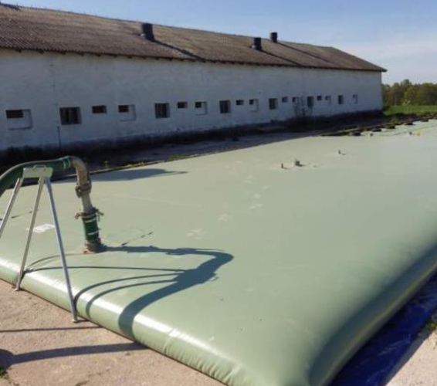
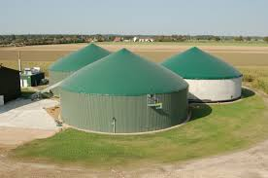
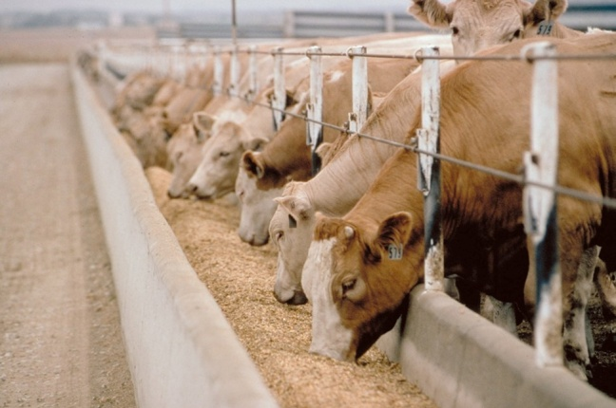
Potential ammonia emission reducing measures in Latvia

Slide 5
Selected and analysed ammonia emission reducing measures in Latvia
Aim | Measure
Effective nitrogen fertiliser application | Precision mineral fertilizer application
 | Fertilization planning and practical implementation
 | Direct application of liquid manure into soil Option 1 – piplines Option 2 – injector Option 3 – band spreader
 | Reduced time for poultry manure incorporation into soil (4 h)
 | Reduced time for slurry incorporation into soil (4 h)
 | Reduced time for litter manure incorporation into soil (12 h)
 | Nitrogen fixation by introducing leguminous plant into crop rotation
Effective manure management outside animal housing | Covering of liquid manure storage Option 1 – expanded clay Option 2 – film Option 3 – tent Option 4 – concrete
 | Construction of new cylindrical manure storage facilities
 | Promotion of biogas production
Development of organic farming | Promotion of organic dairy farming

Slide 6
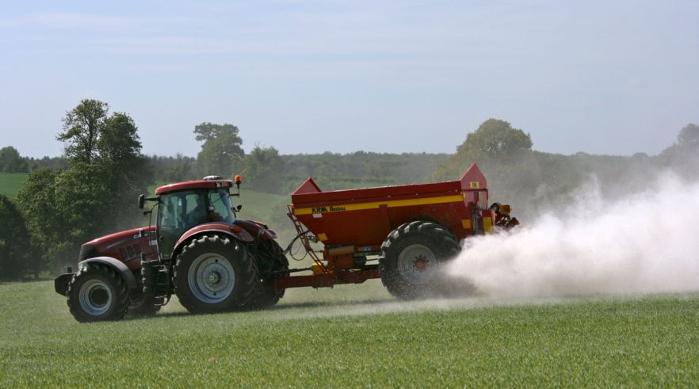
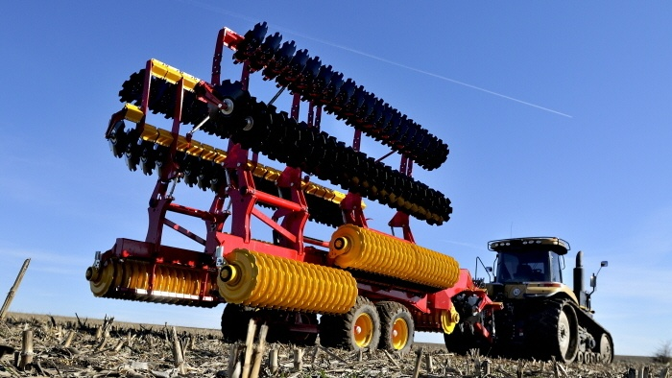
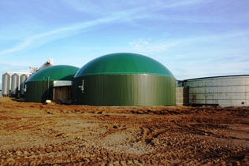
Assessment of costs-effectiveness and ammonia emission reduction potential of selected measures

Slide 7
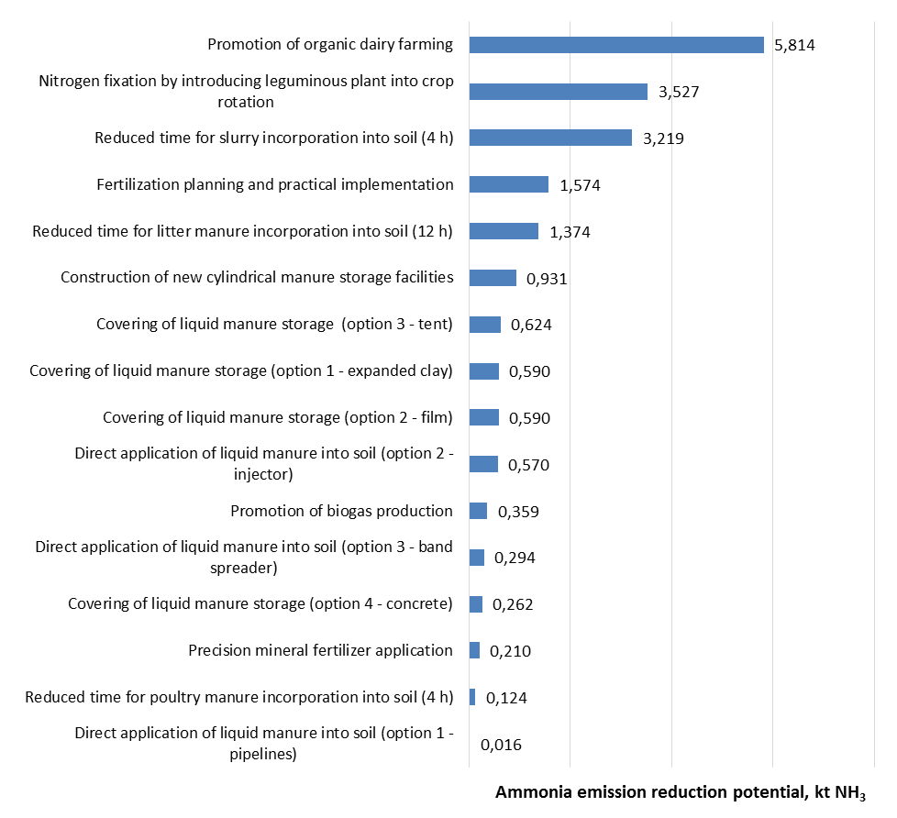
Ranking of measures according to ammonia emission reduction potential (potential calculated for 2021-2030), kt NH₃
Measures with high reduction potential (77% of the total reduction potential)
Measures with medium reduction potential (total 18% of total reduction potential)
Measures with low reduction potential (total 5% of total reduction potential)

Slide 8
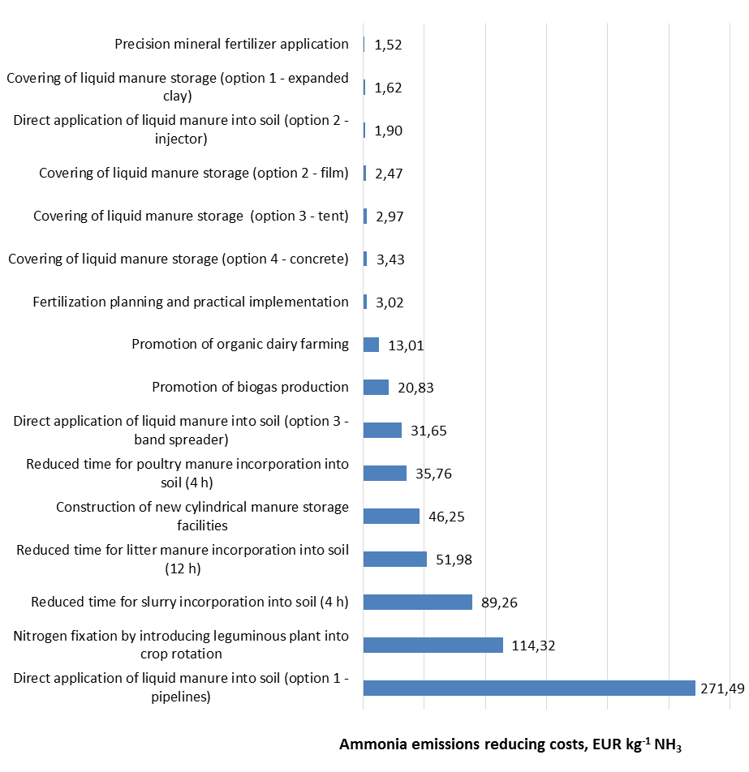
Ranking of measures according to the cost of reducing ammonia emissions, EUR kg⁻¹ NH₃
Cheap measures
Moderately expensive measures
Very expensive measures

Slide 9
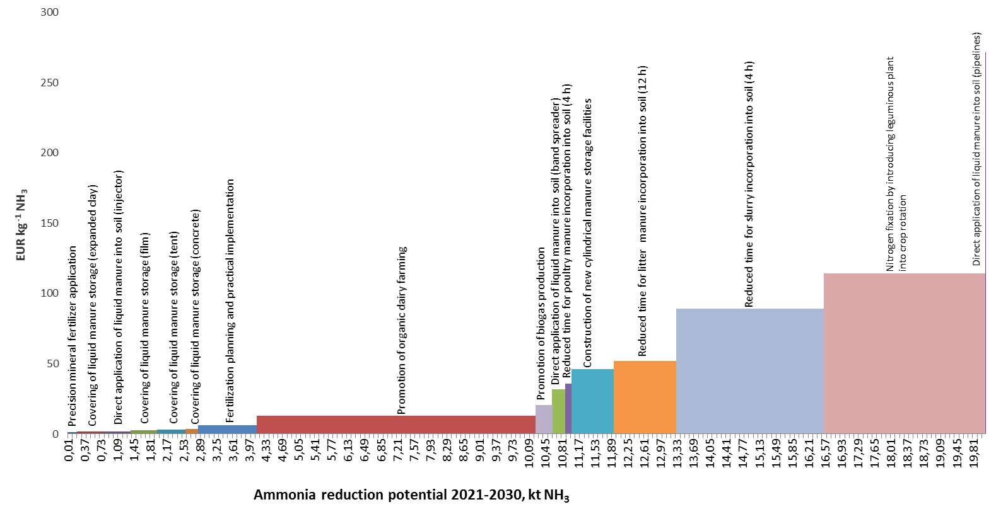
Marginal Abatement Cost Curve (MACC) for ammonia emissions reducing measures
Cost effective measures with high NH₃ emissions reduction potential. These measures are considered to be the most effective both economically and environmentally and should be prioritized for more active implementation in practice.

Slide 10
Marginal Abatement Cost Curve (MACC) for ammonia emissions reducing measures
Cost effective measures but with low NH₃ emissions reduction potential. These measures are considered effective, but with little effect on reducing NH₃ emissions. In order to maximize the impact, the scope for increasing the number of target farms, animals, the target area should be reviewed.

Slide 11
Marginal Abatement Cost Curve (MACC) for ammonia emissions reducing measures
Measures that are cost-inefficient but with high NH₃ reduction potential. These measures are considered to be economically inefficient but very effective from the environmental point of view as they have a significant impact on reducing NH₃ emissions. Therefore, financial support to farms is needed to facilitate the practical implementation of these measures.

Slide 12
Conclusions
Latvian farmers as a whole are ready to move more actively towards climate and environmentally friendly agriculture by introducing various measures on their farms. However, there are currently many technological, environmental, economic and social constraints that hinder the practical implementation of measures on farms.
Detailed evaluation of ammonia emission reduction measures - cost-effectiveness calculations, calculations of emission reduction potential, allow the evaluated measures to be grouped according to their priority:
Cost effective measures with high NH₃ emissions reduction potential;
Cost effective measures but with low NH₃ emissions reduction potential;
Measures that are cost-inefficient but with high NH₃ reduction potential.

Slide 13
Thank You for Your attention!

